Slide 1
Engineering Physics Laboratory
(Course Code : PHY119)
Experiment Number: 2
AIM: To investigate the intensity of light coming through two crossed Polaroids and to verify the Malus’ law

Slide 2
Learning Objectives
To understand the concept of polarization of light.
To learn about the position of the axis of the analyzer (θ) with respect to the axis of polarizer and the polarization intensity (I).
3. To verify the Malus’ law, I = I₀ cos²θ.

Slide 3
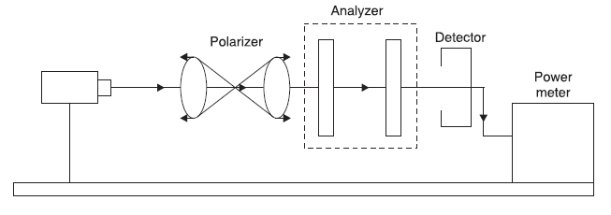
Theoretical background
Malus cosine-squared law states that the intensity of a beam of plane-polarized light after passing through a rotatable polarizer varies as the square of the cosine of the angle through which the polarizer is rotated from the position that gives maximum intensity. Malus’ law, I = I₀ cos² θ

Slide 4
Step by Step guide to perform the experiment on Virtual platform
(1) Go to the link : http://lo-au.vlabs.ac.in/laser-optics/Malus_law/experiment.html
Dr. Subhojyoti Sinha

Slide 5
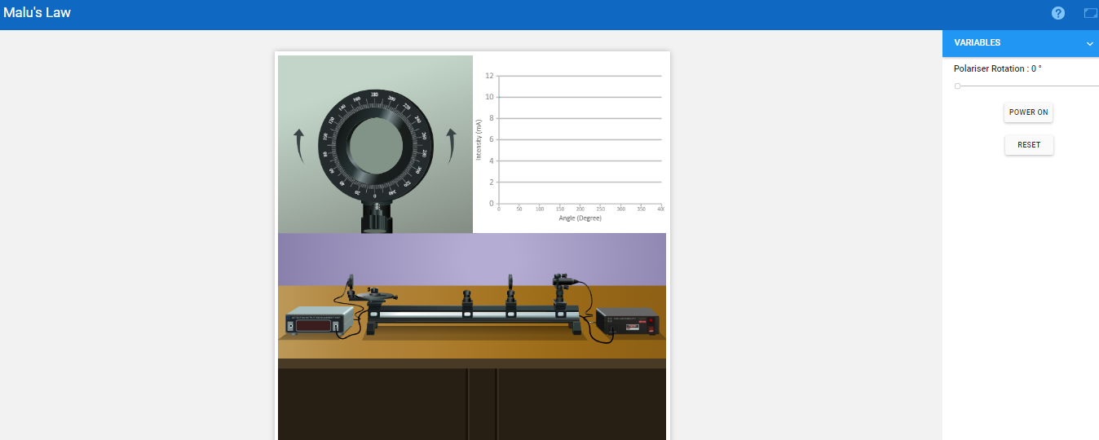
Home page to start experiment

Slide 6
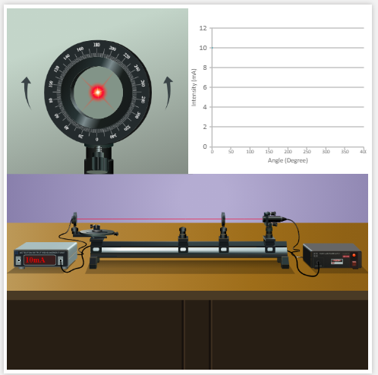
Click on the power on button

Slide 7
Change the polarizer rotation
In a step of 10 °

Slide 8
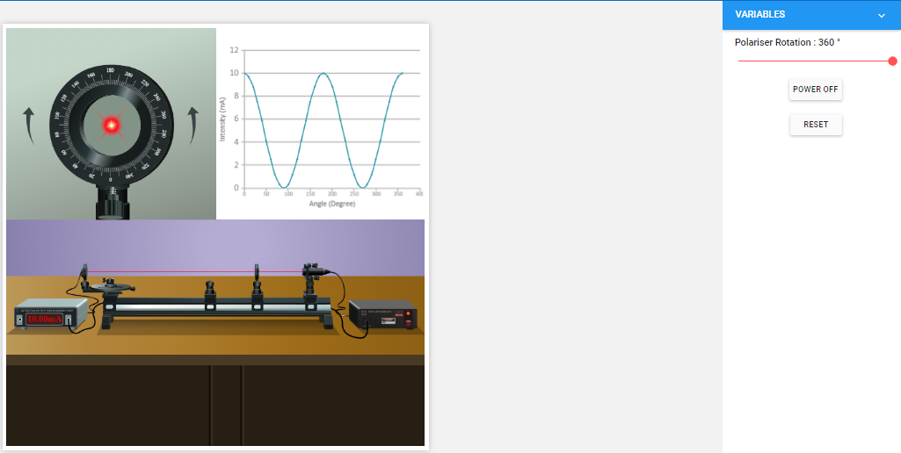
Refer graph for (x,y) coordinates and analyze the graph

Slide 9
Activity Based Session
(go to new link: http://tutor-homework.com/Physics_Help/polarized_light.html)

Slide 10
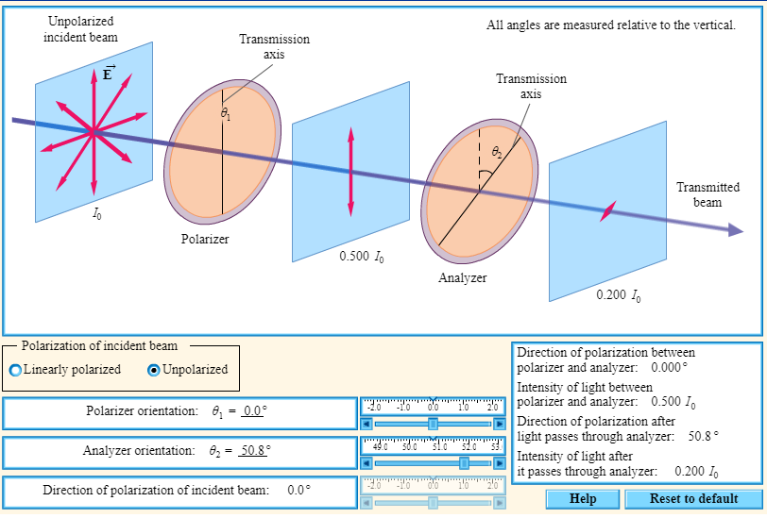
Select incident beam

Slide 11
Select polarization orientation

Slide 12
Note intensity by changing analyzer orientation

Slide 13
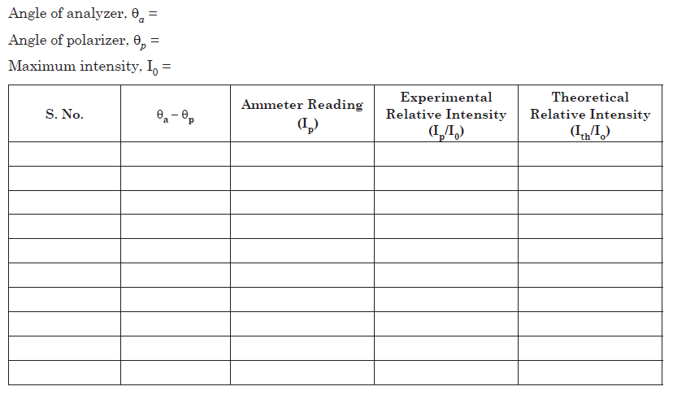
Observation Table

Slide 14
Calculation
The validity of Malu’s law can be verified by plotting a graph between θ vs I_{p}/I₀ and θ vs I_{th}/I₀
For comparison, both the curves must be on the same graph paper

Slide 15
Prepare a graph (to match with vlab)

Slide 16
Precautions (in the lab)
Beam should be along with the axis of Polaroid
Good quality laser beam should be used
Power supply should be continuous
There should be dark room for this experiment.
No obstacle should lie in the path of beam.

Slide 17
Understanding based questions

Slide 18
Understanding based questions
Q
Q1 : A window which can transmit all the incident light without any reflection is called ___________
a) Polarized Window b) Malus Window c) Brewster Window d) Non-reflecting window

Slide 19
Understanding based questions
Q
Q2 : Sound waves can be polarized.
a) True b) False

Slide 20
Understanding based questions
Q
Q3 :If the phase difference between two rays is π/2 and the angle of incidence is not equal to π/4, the emergent light is __________
a) Linearly Polarized b) Elliptically Polarized c) Circularly Polarized d) Non-Polarized

Slide 21
Activity based questions

Slide 22
Activity based questions
Q
Q1 :Polarization of incident beam can be set to
a) Unpolarised
b) Linearly Polarized c) Elliptically Polarized d) Both (a) and (b)

Slide 23
Activity based questions
Q
Q2 :Analyzer orientation can be varied from ______ to ______
a) 0°, 360°
b) -90°, 90°
c) -180°, 180°
d) Automatic

Slide 24
Activity based questions
Q
Q3 : Least count of polarizer and analyzer is_____
a) 0.1°
b) 0.01°
c) 0.001°
d) Undetermined

Slide 25
Activity based questions
Q
Q4 : Intensity of light after it passes through analyzer is _________when polarizer and analyzer set to 45° and 60°, respectively.
a) 0
b) 0.467 I₀
c) 0.5 I₀
d) I₀

Slide 26
Activity based questions
Q
Q5 : what should be the direction of polarization of incident beam to get maximum intensity (I₀) of light? Consider the polarizer and analyzer set to 45° each.
a) 0°
b) 45°
c) 90°
d) Cannot be achieved

